Slide 1

Steps for searching fires data from NPP
By: Dr. Jun Wang & Dr. Lorena Castro García
July 10, 2017

Slide 2
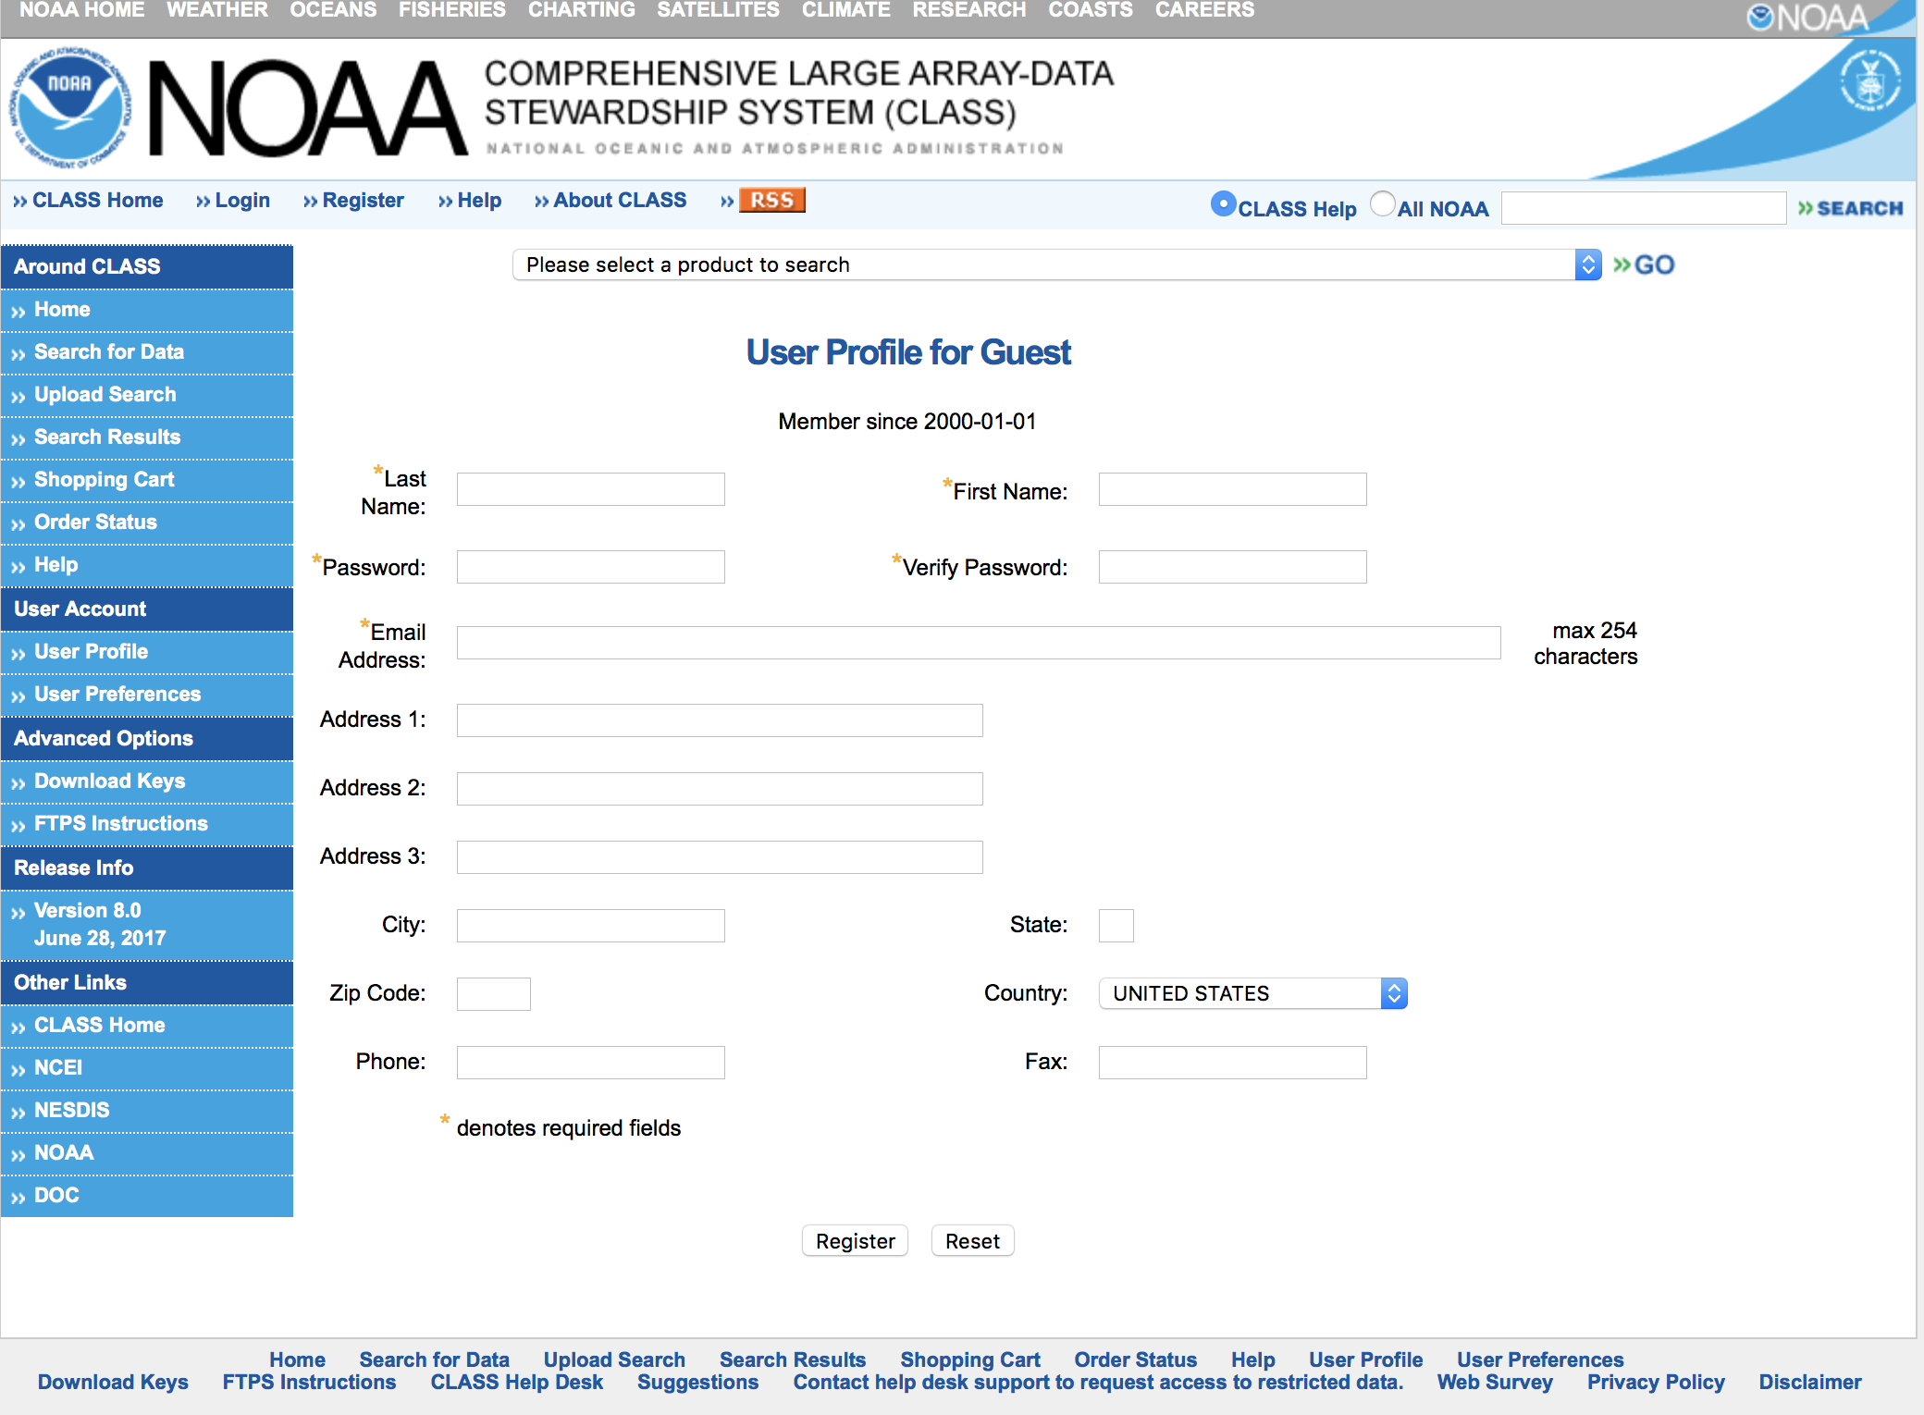
User account
Create a user account at NOOA CLASS website and login it.
https://www.class.ngdc.noaa.gov/saa/products/user_profile

Slide 3
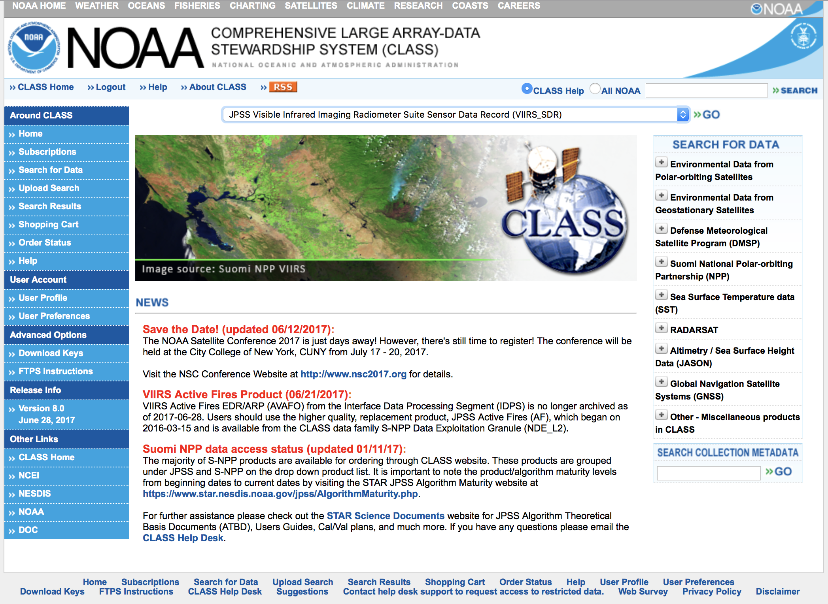
Discovery data
Select a product for search
For this case, let’s go to select VIIRS_SDR

Slide 4
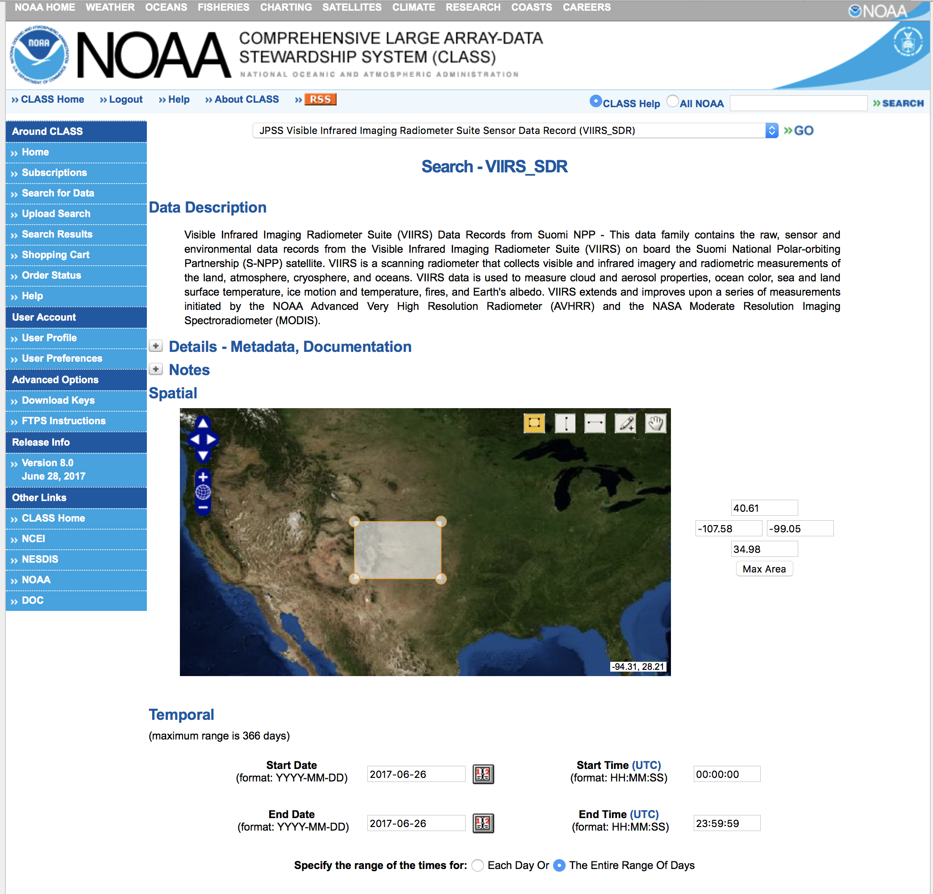
Location and Time
Select area of interest and period of time
In this case, we opted by using the Draw Custom Box tool

Slide 5
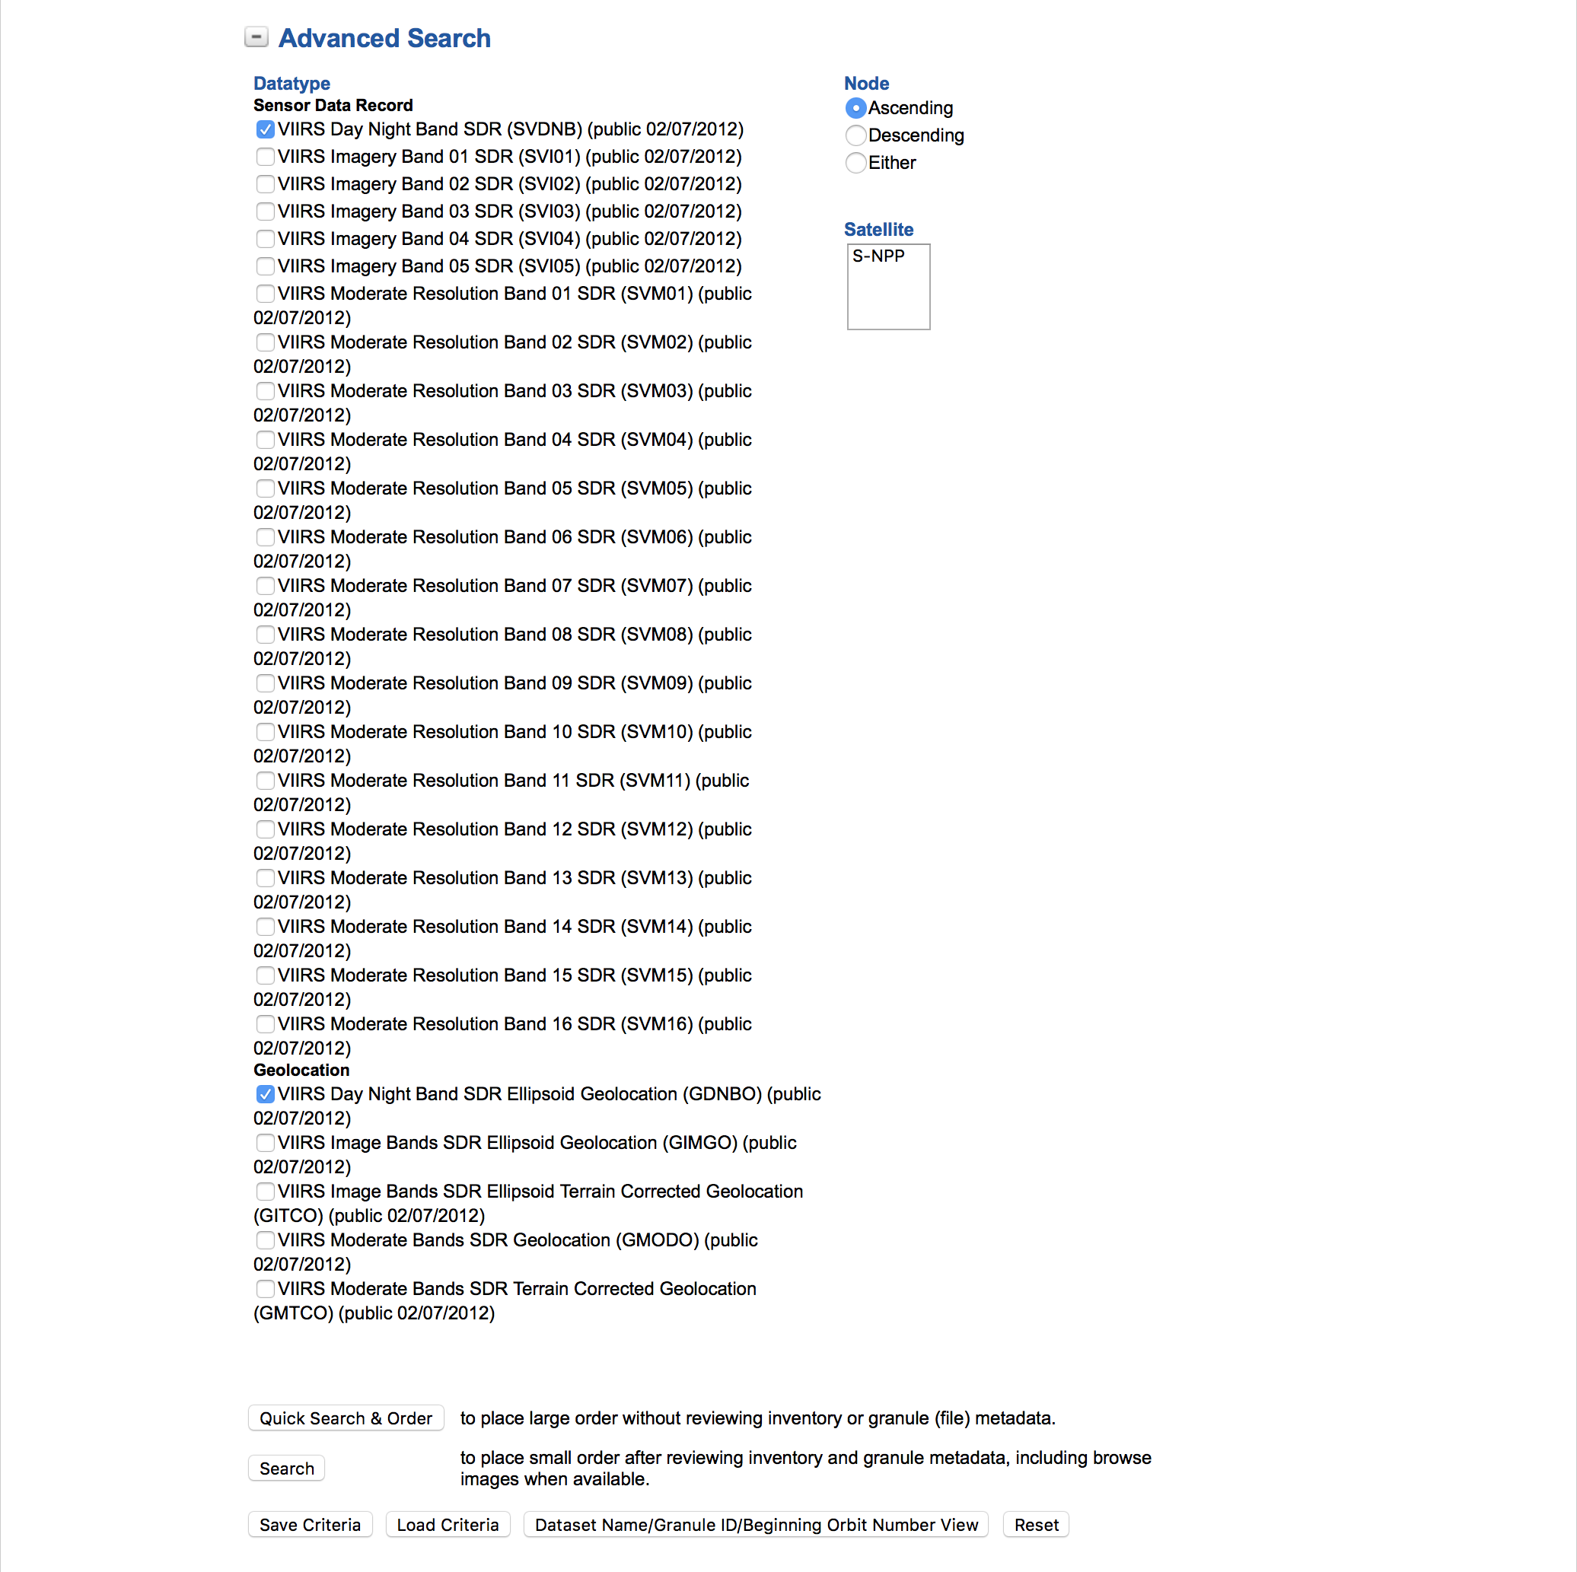
Products and search
Select interest product (s)
sensor: SVDNB and GDNBO
Select the type of search

Slide 6
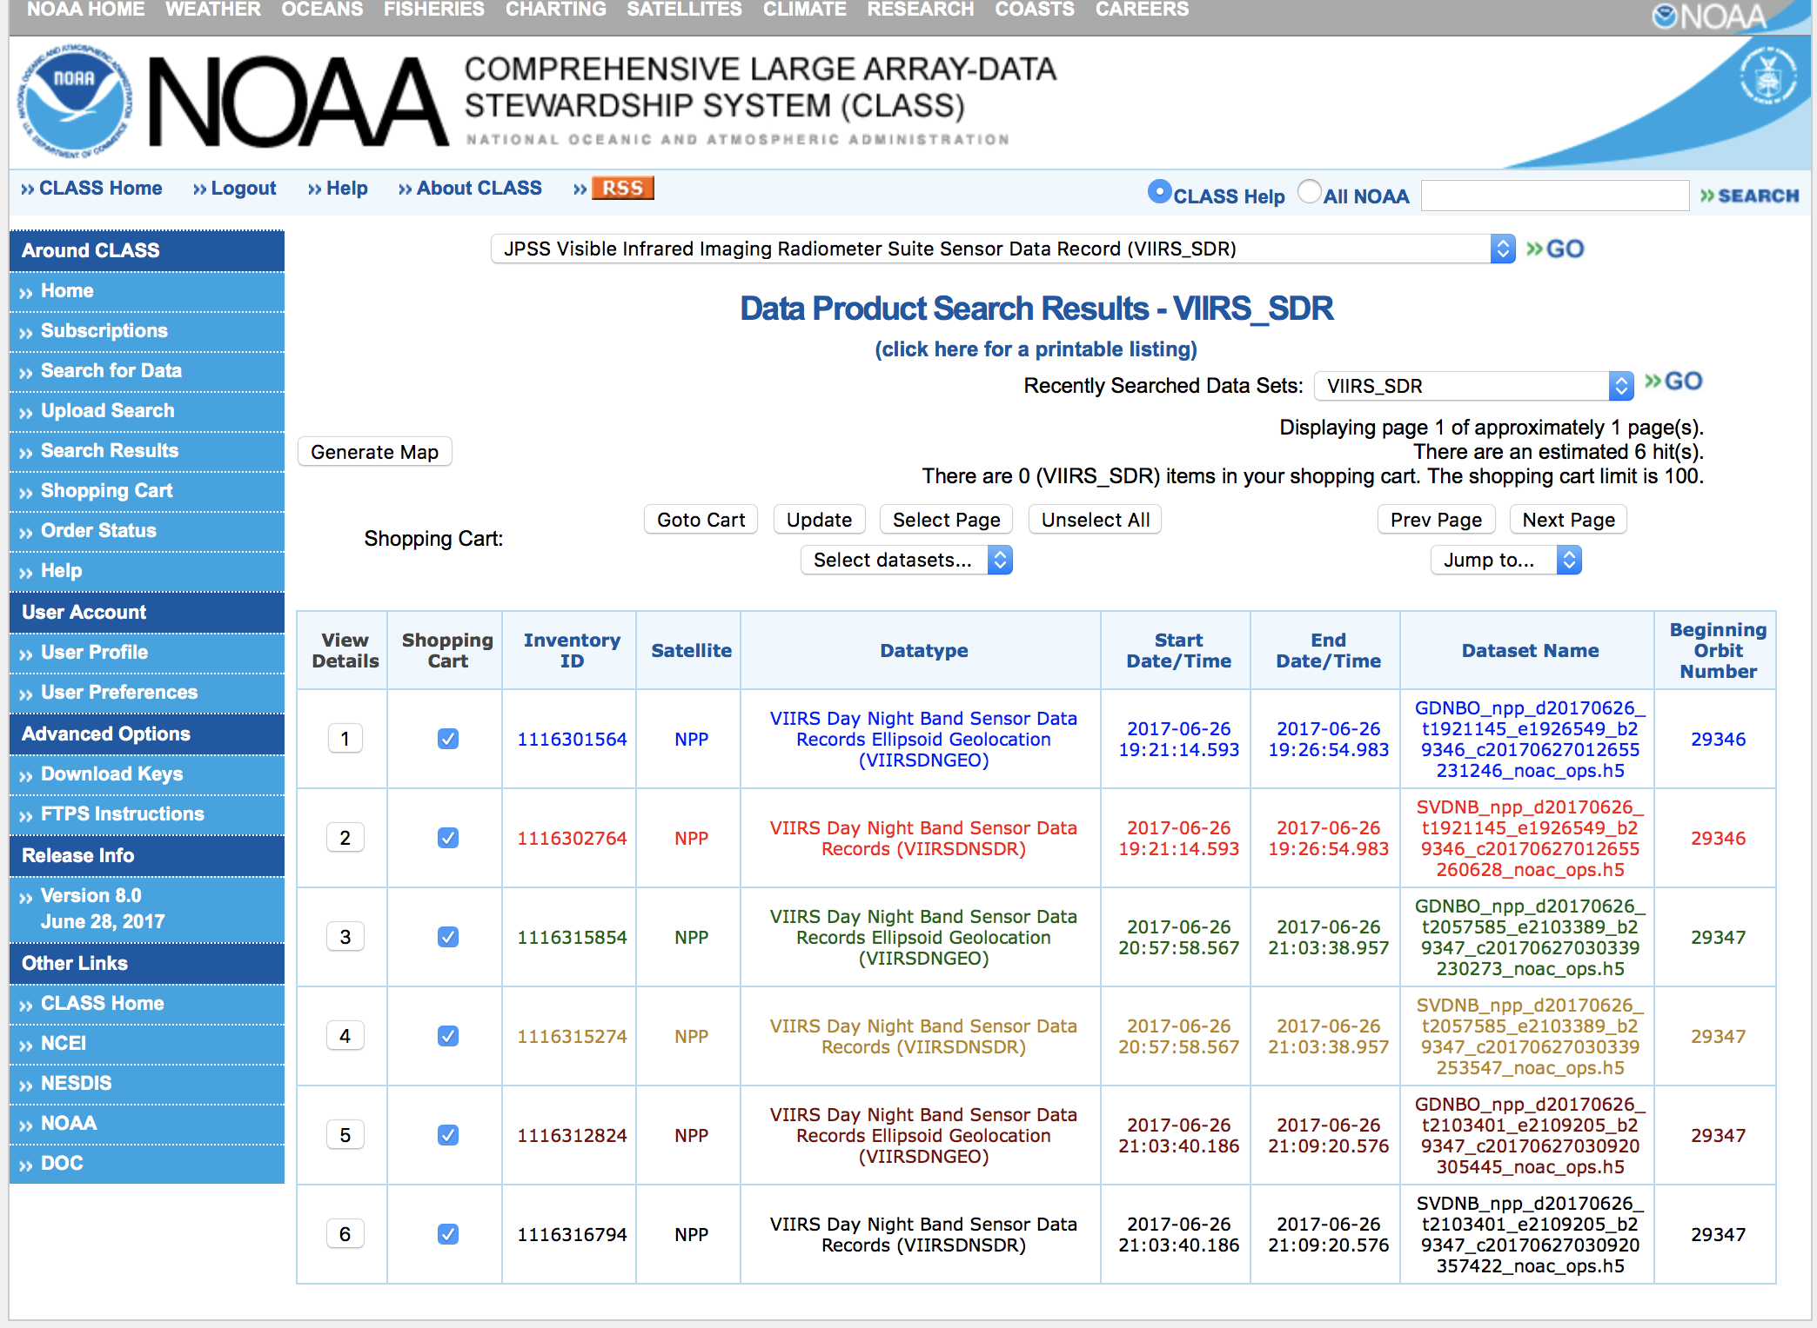
Files
Select files to order
At this point, we have selected the files that we want to retrieve, now we need to press “Goto Cart” option

Slide 7
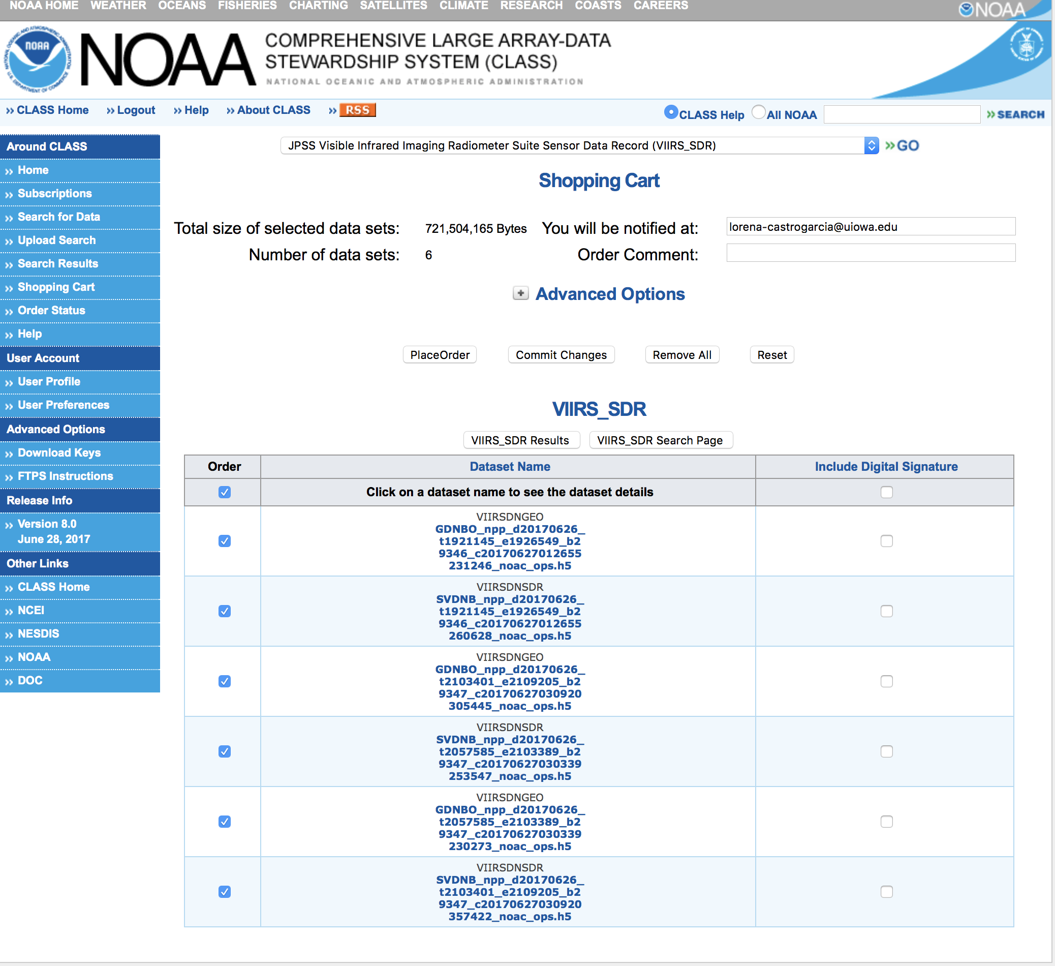
Order
Order files

Slide 8
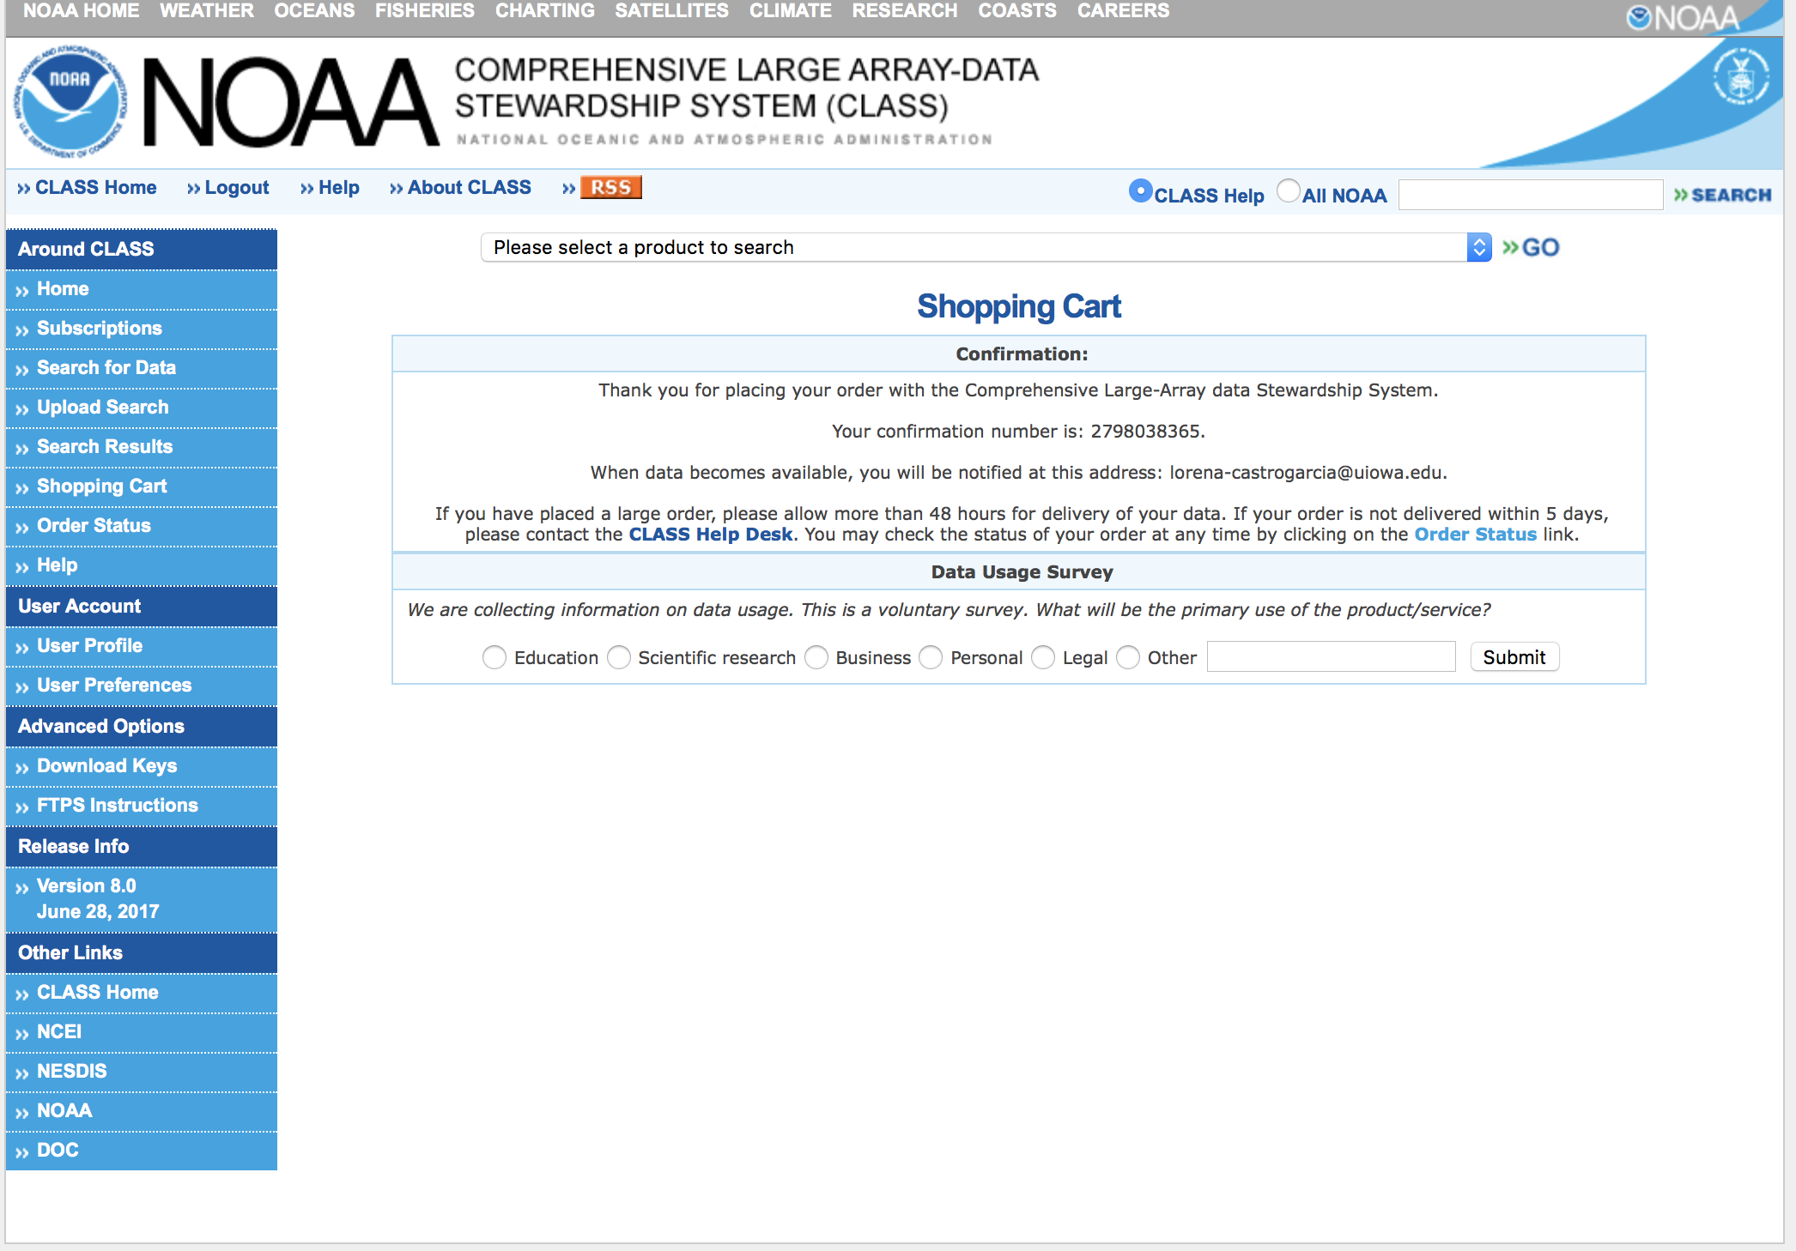
Order confirmation
We will receive a conformation number which we can use for checking the order status

Slide 9
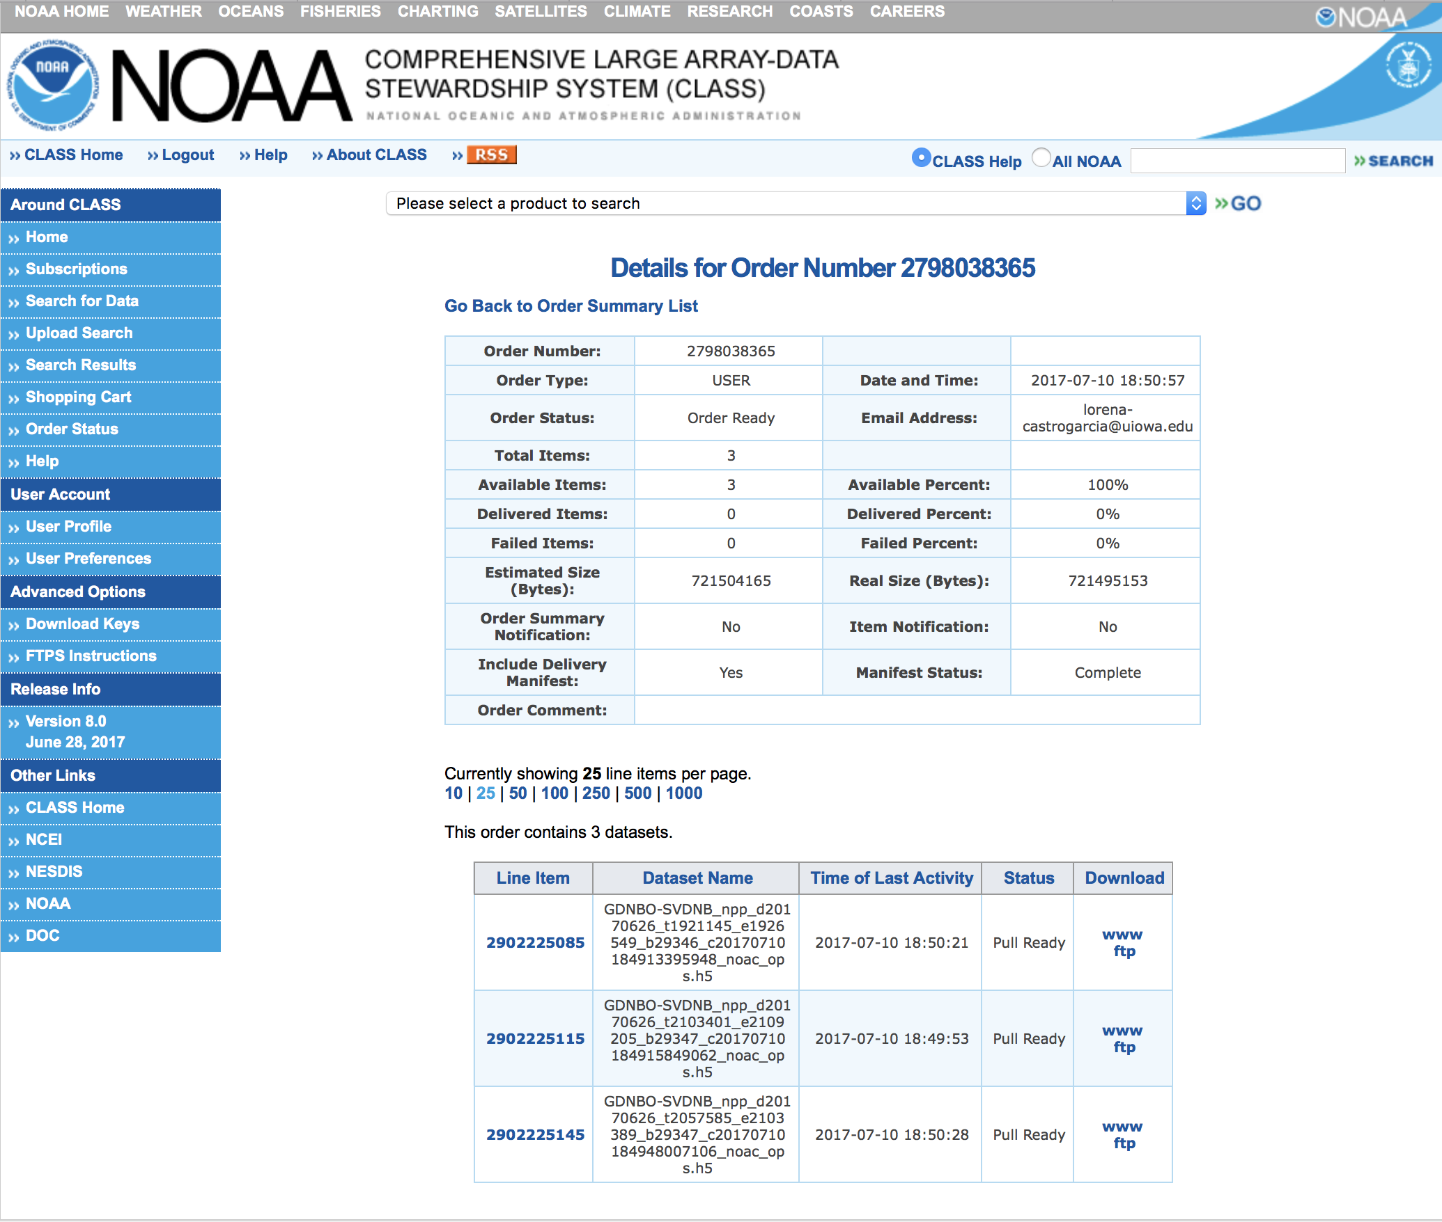
Order status and get files
Check the order status
When the order is ready, we have the options ”www or ftp” for downloading the files.

Slide 10
Contact information
Jun Wang, Professor, Univ. of Iowa;
Phone: 319-353-4483
Center for Global and Regional Environmental Research &
Dept. of Chemical and Biochemical Engineering &
Interdisciplinary Graduate Program in GeoInformatics
4133 Seamans Center, Iowa City, IA 52242-1503
http://arroma.uiowa.edu
Email: jun-wang-1@uiowa.edu
Lorena Castro García (PhD)
Postdoctoral Research Associated
Chemical and Biochemical Engineering &
Center for Global and Regional Environmental Research
University of Iowa
Office: 402 IATL
Email: lcastrogarcia@uiowa.edu

